Slide 1
Methods in Case-Control Gene Regulatory Networks
RIP Meeting
July 29, 2015
Dan Schlauch

Slide 2
Outline
Why gene regulatory network inference?
The challenges of GRN inference.
The challenges of GRN differentiation.
BERE, a novel GRN algorithm.
A novel method for identifying meaningful structural changes in GRNs in case-control studies.

Slide 3
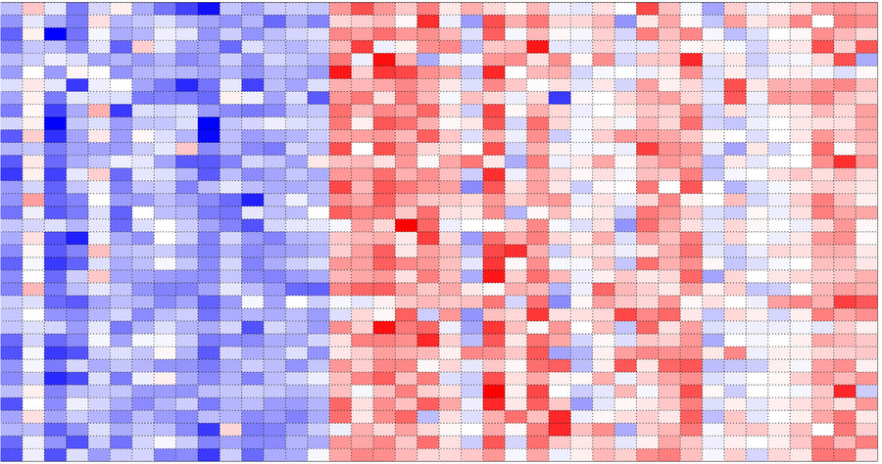
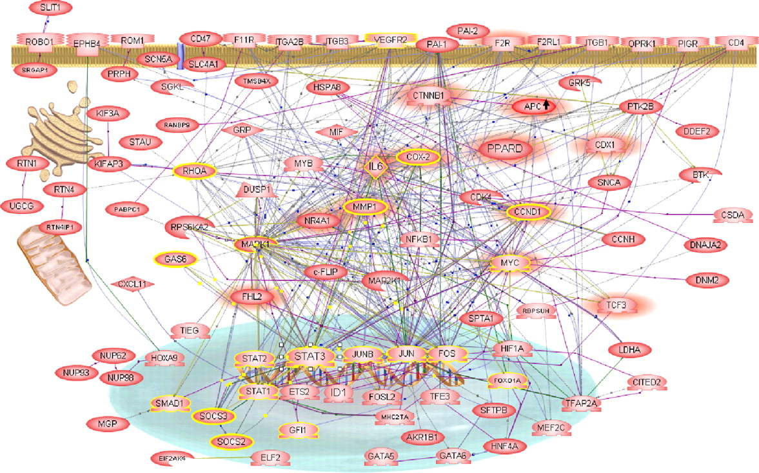
Why Gene Regulatory Network Inference?
Genes are not independent objects.
How are they related?
Amir Abdollahi et al. PNAS 2007;104:12890-12895
Notes:
It is incorrect and unproductive to think of genes as isolated entities.
We need to take a system-wide view to understand.
Also more useful for understanding how complex changes affect phenotype and for predicting responses to therapies.

Slide 4
GRN Inference
Goal: Reverse engineer regulatory mechanisms based on our set of information.
Information may include
Gene expression data
DNA sequence information
Known protein-protein and protein-DNA interactions.
Common approach: Model GRN as a graph with genes as nodes and edges as molecular interactions.
Notes:
Information may also include bibliome, known metabolic networks (KEGG), functional annotations (GO)
Molecular interactions may be direct or indirect.
Typically, Absence of edge between two nodes implies conditional independence

Slide 5

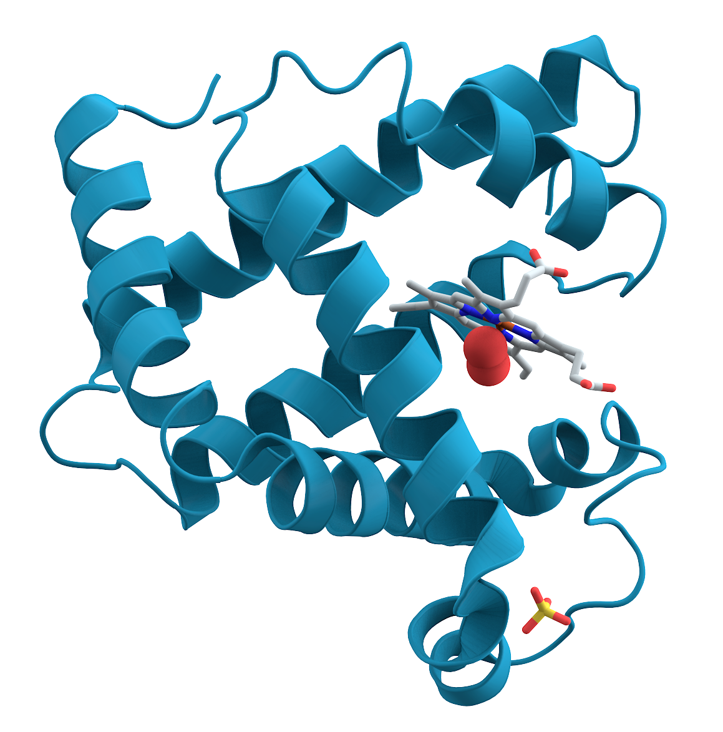
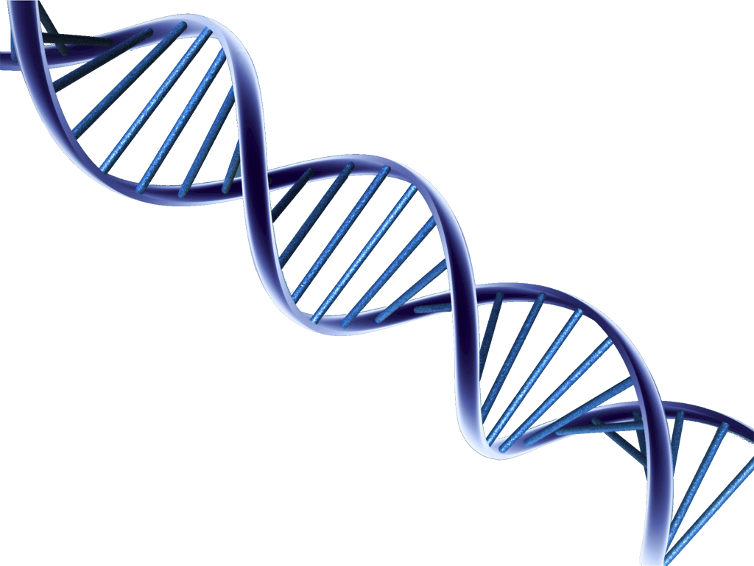
Biological Challenges
Measurements of gene expression are at the mRNA level.
Measurements only consist of mRNA abundance.
Experimental data is collected as static snapshots.
Biological variability can be difficult to induce.
Translation
Transcription
Regulation
Notes:
Regulatory interactions are often based on some kind of coexpression.
i.e. we want to measure protein level interactions, but we must use mRNA level measurements.
protein-protein interactions, post-translational modifications
Even time course microarrays are not collected at the time precision to observe pathways.
Perturbation, via system-wide, or gene specific approaches. Gene-specific is not practical for whole genome. Both impractical for in vivo studies. Must rely on natural expression variation in cells.

Slide 6
Statistical Challenges
Gene expression measurements are noisy, biased.
Model complexity may require the estimate of too many model parameters.
May be computationally intractable.
May be statistically undetermined.
Notes:
RNA seq has helped reduce technical noise, but there still exists other sources, such as biological noise.
For networks with discrete edges, we have 2^p possible networks
For example, if we consider a definition of an edge to be derived from a function of coexpression conditional on all others we see the problem is undetermined at p>n
More complex models may be more biologically correct, but more difficult to discern statistically.

Slide 7
How to address dimensionality?
Assume sparsity.
Define simpler model to reduce parameter space.
Use a priori information to eliminate potential edges.
Use regularized regression methods to impose sparsity.
Use heuristic approaches based on priors.
Define model interpretation to allow edges to define “influence”.
A
B
C
Notes:
This approach is utilized in gene relevance networks. Interpretation is weakened, as data there is massive multicolinearity and almost all genes are correlated in some way.

Slide 8
Challenges in GRN inference
(p choose 2) edges
Notes:
Consider a set of genes, often the entire set in the genome.
The set of all pairwise interactions is p choose 2

Slide 9
Challenges in GRN inference
Notes:
We use a priori knowledge about which nodes we are interested in. In this case we may declare that we are interested only in genes which are known TFs, and now we only consider directed interactions where the parent is from this smaller subset

Slide 10
Challenges in GRN inference
Notes:
Major reduction in dimensionality, could be two orders of magnitude fewer edges to estimate.
SEREND and PANDA among others have adopted this approach.
Bipartite network, which serves as the framework for what I'm discussing today.

Slide 11
The network differentiation problem
Background:
Transcription factors may behave in different ways in different contexts.
The targeted set of genes are defined by post-translational factors not measured by gene expression.
These changes in “involvement” may not be readily observed using standard differential gene expression analyses.
Notes:
TFs act as switches in regulatory pathways.
We are using mRNA expression, which is insufficient for describing the comprehensive impact on potential targets.
Methylation, protein interactions, presence or absence of supportive TFs will all alter the set of targets that a TF acts upon

Slide 12
Network differentiation challenges
Current network inference methods yield relatively poorly predictive edgeweights at the individual interaction level.
Comparison of two networks involves the comparison of millions of noisy edges.
Best algorithms rely heavily on static information.
Notes:
Algorithms often use sequence motifs as regulatory priors, or in the case of PANDA, as the regulatory initialization. In PANDA's case the motifs, though not considered priors in the Bayesian sense, are highly influential (too influential) to final network.

Slide 13
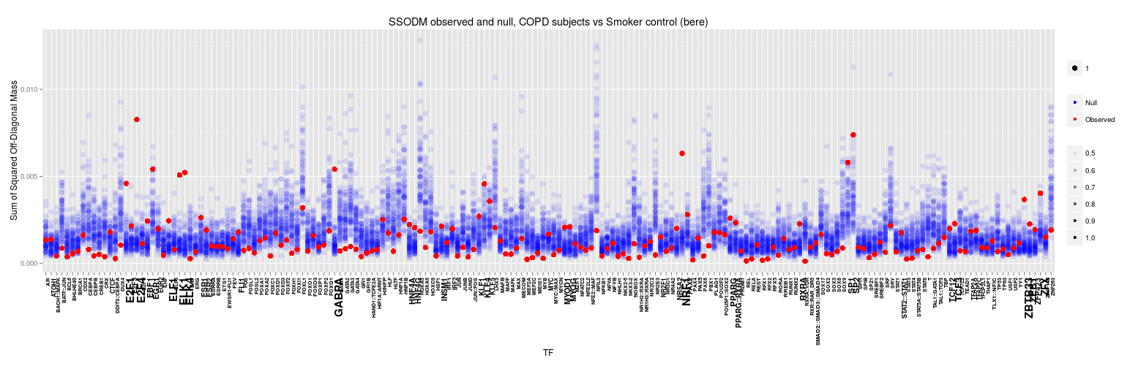
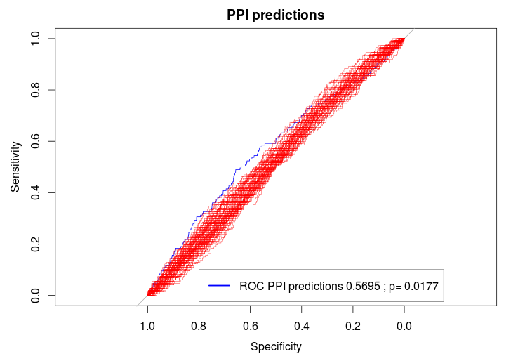
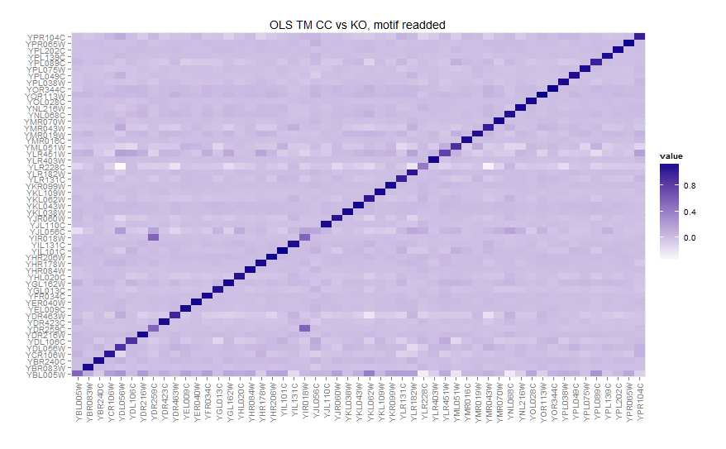
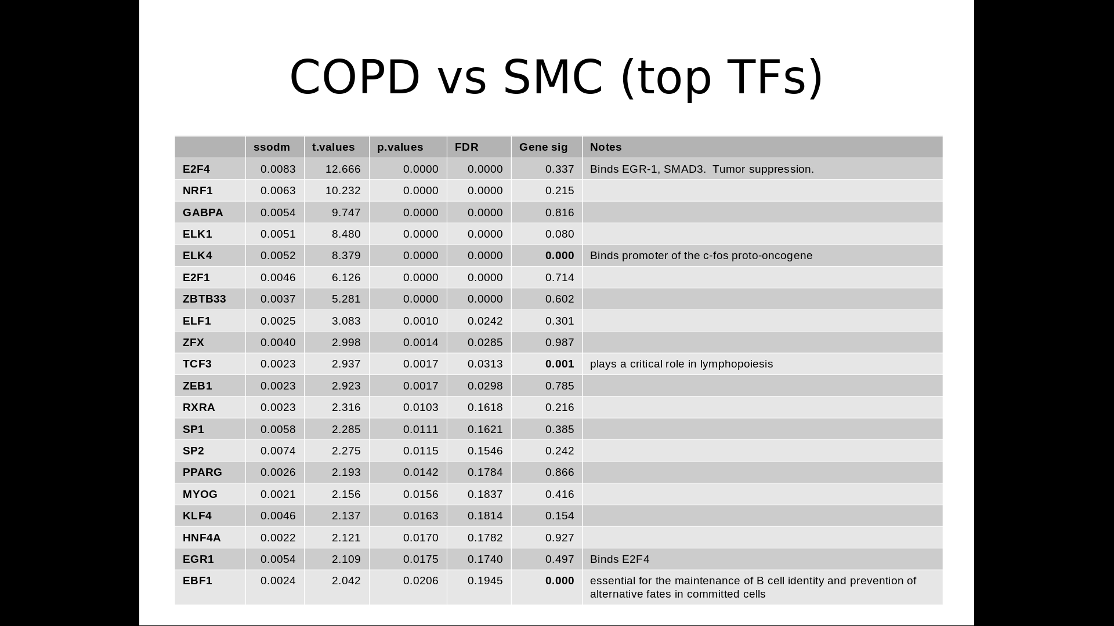
Gene expression Sequence Motifs
Observed Partition
COPD vs SMC
Random Partitions
Null x 1000
BERE
}
Observed
COPD
Network
Observed
SMC
Network
Null
NetworkA
Null
NetworkB
X 1000
Transition Matrix
}
X 1000
Transition Matrix analysis

Slide 14
Gene expression Sequence Motifs
Observed Partition
COPD vs SMC
Random Partitions
Null x 1000
BERE
}
Observed
COPD
Network
Observed
SMC
Network
Null
NetworkA
Null
NetworkB
X 1000
Transition Matrix
}
X 1000
Transition Matrix analysis

Slide 15
Bipartite Edge Reconstruction from Expression Data
i
A
B
C
j
TF A
Motif
Data
TF B targets
?
TF A targets
TF C targets
Expr
Data
Samples
Genes
Gene j
Gene i (TF A)
Notes:
This is an overview of the problem.
In this example, we are interested in estimating the dotted line between A and i
Below we have the gene expression matrix

Slide 16
BERE
Penalized Logistic Regression Classification
Indirect
R-squared
Motif
Data
TF B targets
Direct
TF A targets
TF C targets
Expr
Data
Samples
Genes
Gene j
Gene i
(TF A)

Slide 17
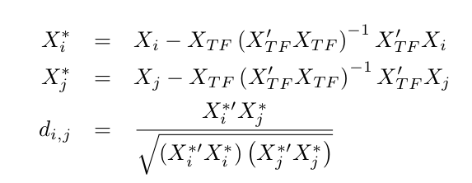
BERE - direct
Divide evidence for regulation into 2 parts:
1.) Direct evidence
Measured by squared conditional correlation with expression level for transcription factor.
This results in a limited order partial correlation network. Typically feasible to run with without regularization.
Notes:
We are calculating the partial correlation between X_i and X_j

Slide 18
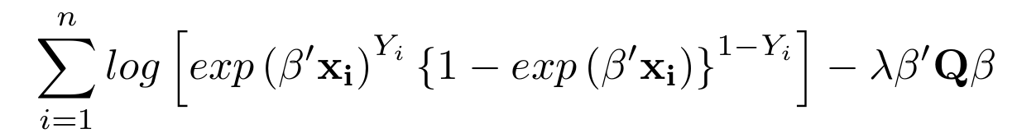
BERE – indirect
2.) Indirect evidence
Classification from a regularized logistic regression, with penalty model matrix as inverse TF A expression levels.
Regularization here is across samples. We are not attempting to do feature selection and are using an L₂ penalty.
The goal is to find the maximum of the penalized log likelihood function:
Q is diagonal with values equal to the inverse transcription factor expression.
Notes:
Approach this part as a classification problem.
In summary, we expect the targets of TF A to have an expression pattern that is distinguishable. We use our set of suspected Targets to fit the model
We use present/absent for JASPAR motifs as class labels and run a regularized logistic regression.
LL equation:
Y_i is an indicator that the gene i is a target of TF A.
x_i is gene expression of gene i
Betas are the fitted, penalized coefficients that we use to classify gene j with respect to TF A

Slide 19
BERE – consensus
How to combine predicted edgeweights?
1.) Rank indirect and direct contributions by TF.
2.) Combine with a weighted sum.
Greater organism complexity → greater indirect weight.
Optimal indirect weights
DREAM5 data | alpha
In Silico | .33
E. coli | .61
Saccharomyces cerevisiae | .88
Notes:
DREAM 5 challenge, consensus networks tended to perform better.
Distributions differ for indirect vs direct, both for true negatives and true positives. So, non-parametric.
Question becomes appropriate proportional contribution of direct vs indirect
In all cases, a 50/50 split was more effective than indirect or direct by itself.
Results are completely in line with suspicions that greater complexity calls for greater need to account for post-translational factors.

Slide 20
BERE - summary
Method overview:
1.) Model gene regulatory network as a bipartite graph between m transcription factors and p genes.
2.) Consider the direct evidence of regulation.
The squared conditional coexpression of gene i and gene j, where gene i is a transcription factor.
3.) Consider the indirect evidence of regulation.
Use presence of sequence binding motif for TF i near gene j as a classification label and fit a penalized logistic regression model across all genes.
4.) Combine indirect and direct evidence into a score for network edgeweights.

Slide 21
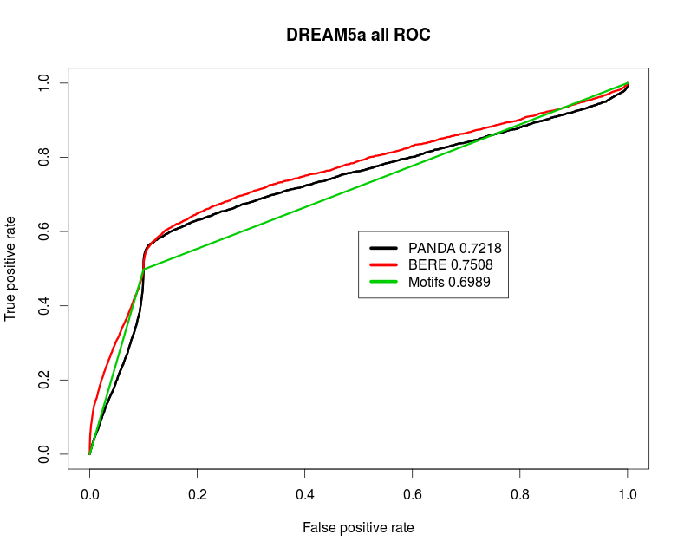
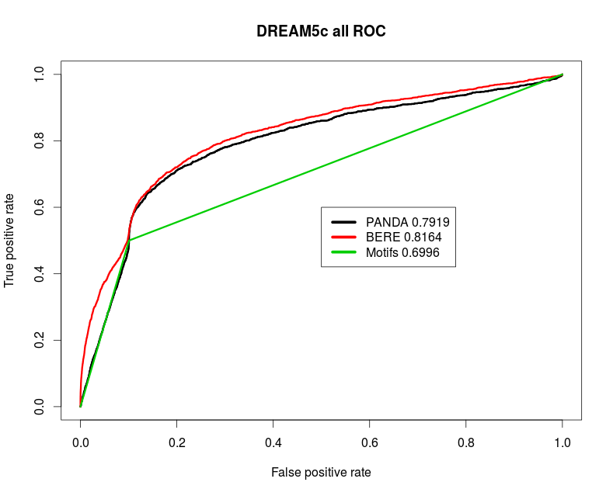
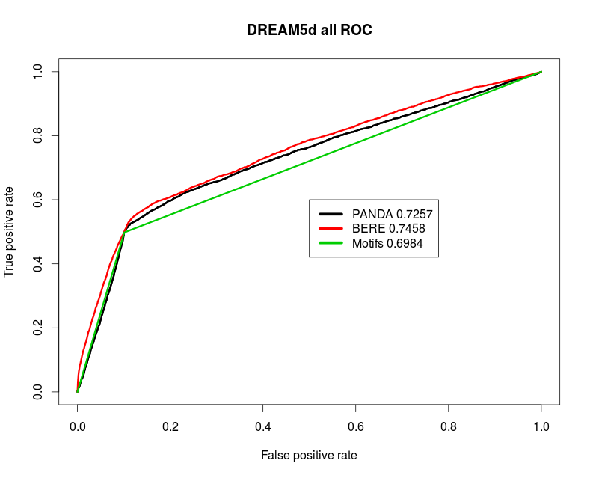
BERE
In Silico
In Silico
E. coli
E. coli
Yeast
Running R package: 8GB RAM, 2.40Ghz | Time
2555 genes, 53 TF, 106 samples | 11s
17342 genes, 189 TF, 226 samples | 12m, 20s
Notes:
DREAM5 data, using different validation approaches.
Comparison of BERE with PANDA, which has been shown to outperform other common network inference methods, SEREND, ReMoDiscovery, for this analysis.
Importantly, this method runs very quickly, which is critical for downstream analysis where we use a resampling approach.

Slide 22
Gene expression Sequence Motifs
Observed Partition
COPD vs SMC
Random Partitions
Null x 1000
BERE
}
Observed
COPD
Network
Observed
SMC
Network
Null
NetworkA
Null
NetworkB
X 1000
Transition Matrix
}
X 1000
Transition Matrix analysis

Slide 23
A Pathway model

Slide 24
Transition Matrix Approach
We can view the problem as a dimension reduction problem.
Few TFs
Controls
Cases
Many Genes
Notes:
ID'ing diff targeting:
therapeutic target,
uncover a disease substructure identify biomarkers or gexp patterns
In other words, we want to express the differentiation between adjacency matrices as a lower dimensional matrix.
There are many ways we could approach this problem, NMF, PCA, SVD, LDA
Each of these approaches could have some value, but a common issue across these methods is that the vectors are difficult to interpret.
All may have value here, but we propose a different approach
Why compare? Biological mech disease

Slide 25
Transition Matrix Approach
Consider two adjacency matrices...
TFs
TFs
Genes
Genes
Notes:
Why compare? Biological mech disease
ID'ing diff targeting:
therapeutic target,
uncover a disease substructure identify biomarkers or gexp patterns

Slide 26
Transition Matrix Approach
Consider two adjacency matrices...
TFs
TFs
Genes
Genes

Slide 27
Transition Matrix Approach
Consider two adjacency matrices...
Smoker Control
Tau
COPD
X
~

Slide 28
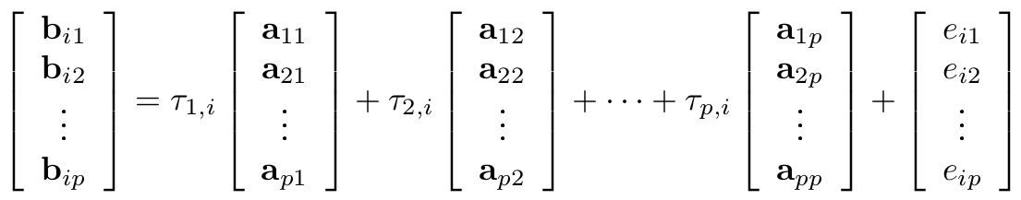
The Transition Matrix (Tau)
Consider two adjacency matrices, A and B representing the adjacency matrices for two GRNs estimated from a case-control study. Each matrix has dimensions (p x m) representing the set of p genes targeted by m TFs. We seek a matrix, T, such that
B = AT + E
Notes:
Where E is our error matrix, which we are attempting to minimize.

Slide 29
The Transition Matrix (Tau)
Interpretation: Each column in the TM can be thought of as being the best linear combination of columns in the control AM that “create” the columns in the COPD.
Reasoning: We want to focus on changes in targeting behavior of a TF in terms of biologically recognized alternative targets.
Constraints:
In reconstructing case-targets for a TF, first account for targets in control for that TF.
Assume target-transfer is sparse.
Notes:
- i.e. truly random variation will not be accounted for here. Variation must systematically be related to targeting patterns of another TF.
-We want to give top priority...
- i.e. we are willing to assume that most TFs do not transfer targets between case-controls. And use TM for feature selection

Slide 30
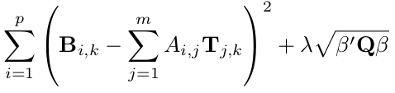
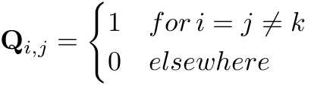
The Transition Matrix (Tau)
We can satisfy these properties with an L₁ regularization.
For a column, k, we perform the following error minimization.
Penalty model matrix is a diagonal matrix with value 0 for it's own TF and 1 for all others.
Notes:
Could have used OLS without issue, but we wanted to impose our diagonal preference and sparsity constraint

Slide 31
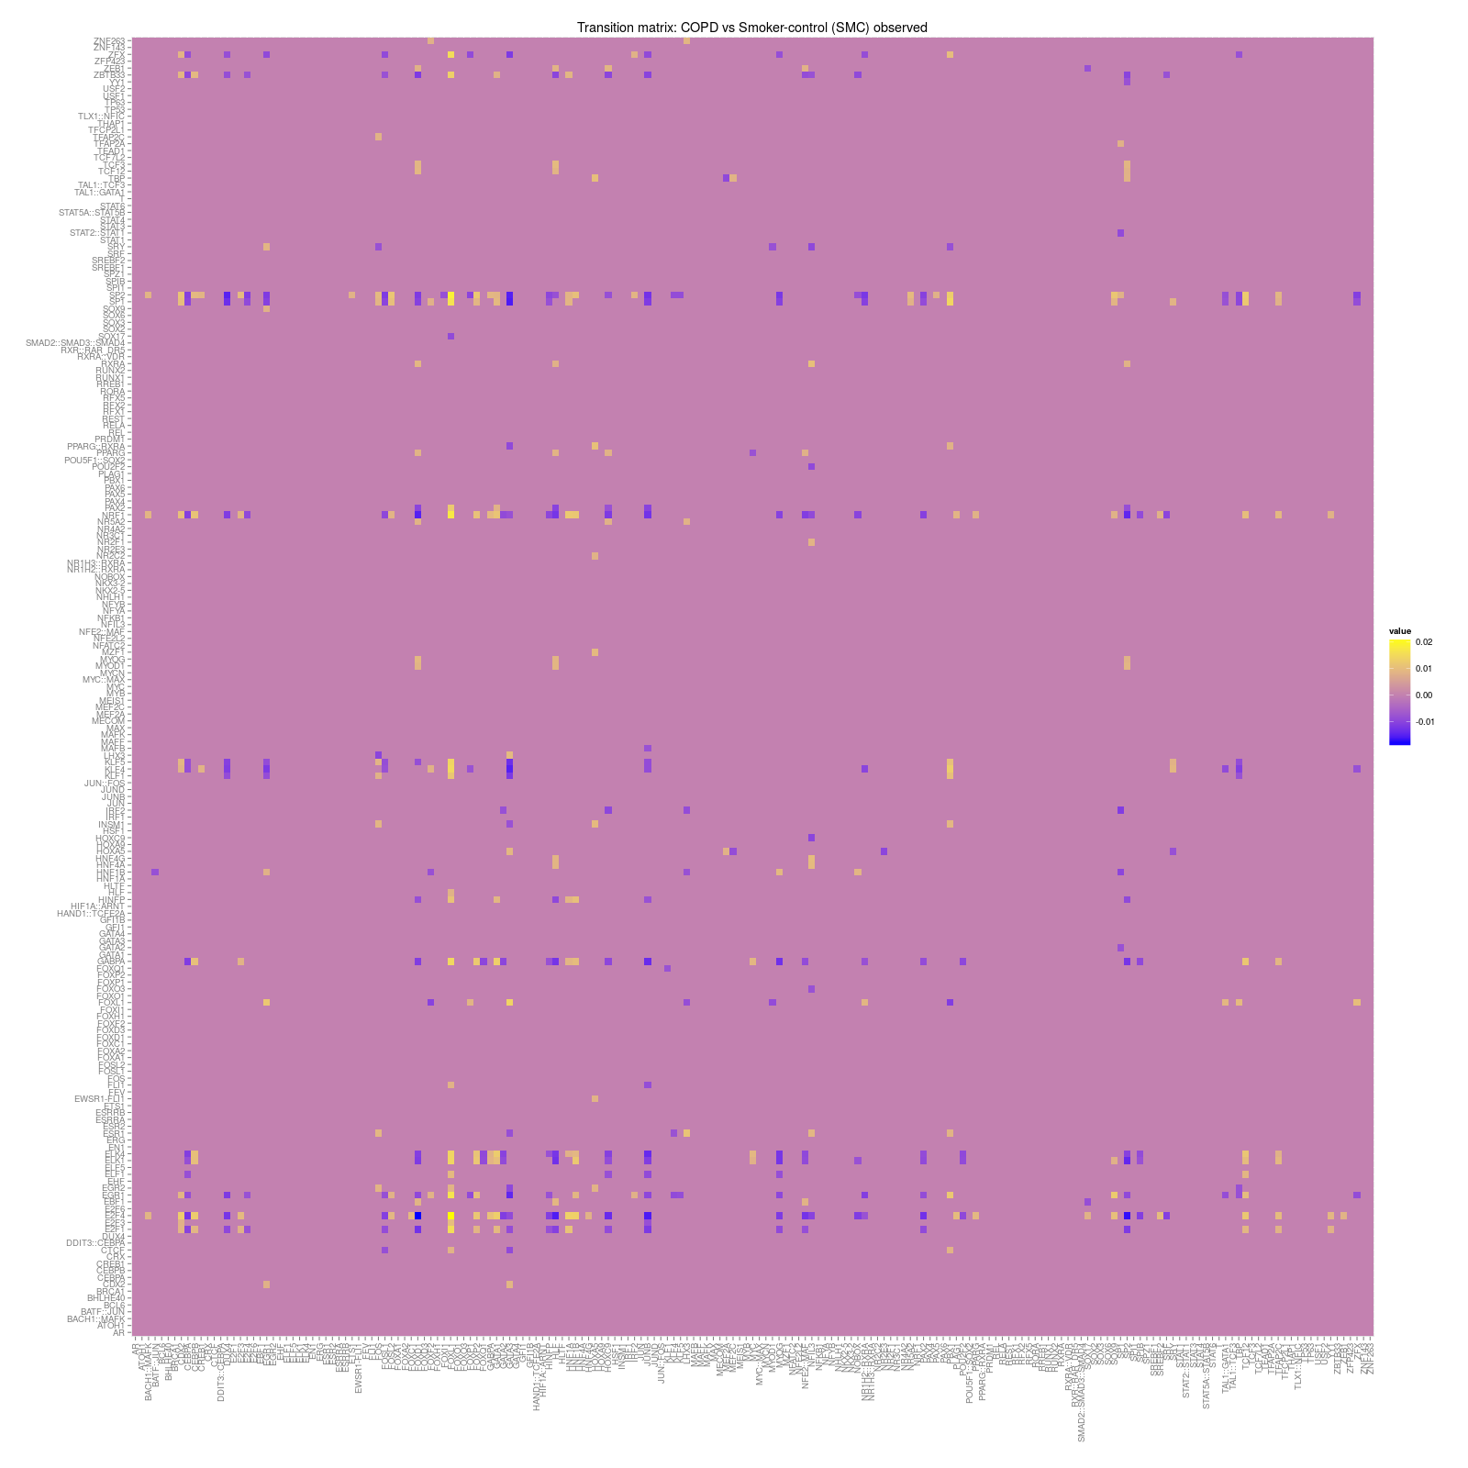
The Transition Matrix (Tau)

Slide 32
An Example
A
B
C
D
1
2
3
4
5
6
7
8
A
B
C
D
Control Network
Cases Network
A
TM =
B
C
D

Slide 33
Biological Mechanism
Suggested mechanism #1:
Differential methylation of the gene for TF C?
-CH₃
A
B
C
D
1
2
3
4
5
6
7
8

Slide 34
Biological Mechanism
Suggested mechanism #2:
Protein complex of B-C-? with unknown 3rd protein?
?
A
B
C
D
1
2
3
4
5
6
7
8

Slide 35
Gene expression Sequence Motifs
Observed Partition
COPD vs SMC
Random Partitions
Null x 1000
BERE
}
Observed
COPD
Network
Observed
SMC
Network
Null
NetworkA
Null
NetworkB
X 1000
Transition Matrix
}
X 1000
Transition Matrix analysis

Slide 36
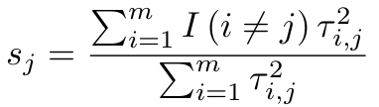
Evaluating the Transition Matrix
We want to quantify the change in targeting which has a biological basis. The overall TF involvement can be simply measured as
s_{j} (differential TF involvement) is the proportion of variability in targeting for TF_{j} in transitioning from controls to cases which is explained by alternative TF targets.
Null distribution depends on motif structure and can be estimated via resampling on a per-TF basis
Notes:
Si is the statistic that we use to identify specific TFI. We have not yet started to determine the specific characteristics it has acquired.

Slide 37
Permutation inference on differential TFI statistic
1. Gene expression samples are randomly assigned to case and control forming the null-case and null-control with group sizes preserved.
2. GRNs are reconstructed for the null-case and null-control with the same prior regulatory structure.
3. The transition matrix algorithm is applied for the two null networks.
4. The differential TFI is calculated for each TF.
5. Repeat 1-4 1000 times.
Notes:
Si is the statistic that we use to identify specific TFI. We have not yet started to determine the specific characteristics it has acquired.

Slide 38
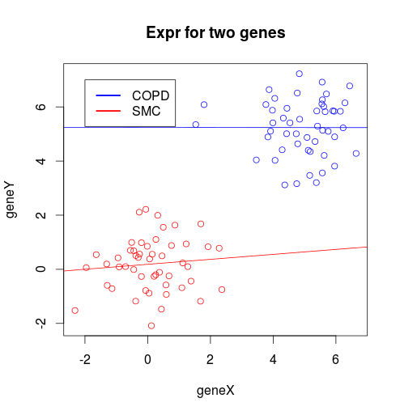
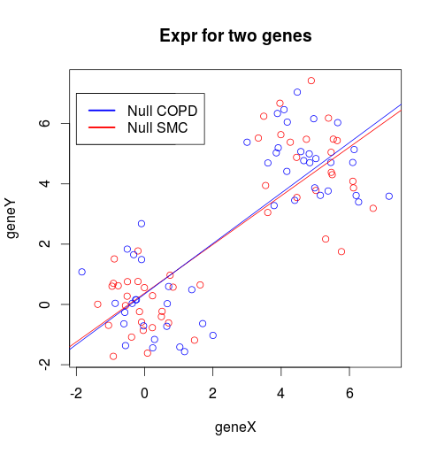
Is this a valid estimation of the null distribution of dTFI?
Concern:
Variance of test statistic may be inflated.
Example: Two highly correlated genes
- Power to detect interaction will be greater under the null
- Edges under the null may be more stable.
- Transition may be less variable under the null
- p-values for observed transition may become smaller,
i.e. variance inflation
Notes:
Si is the statistic that we use to identify specific TFI. We have not yet started to determine the specific characteristics it has acquired.

Slide 39
Is this a valid estimation of the null distribution of dTFI?
Randomly select 200 samples
Calculate dTFI:
1.) Within phenotype
2.) Across phenotype
(observed)
3.) Random phenotype
Store values
COPD
(50)
TM
COPD
(50)
Homogenous samples
TM
TM
SMC
(50)
TM
SMC
(50)
Resample 500 times
Mixed
(50)
TM
Mixed
(50)
Heterogeneous samples
Mixed
(50)
Mixed
(50)
TM
Notes:
Si is the statistic that we use to identify specific TFI. We have not yet started to determine the specific characteristics it has acquired.

Slide 40
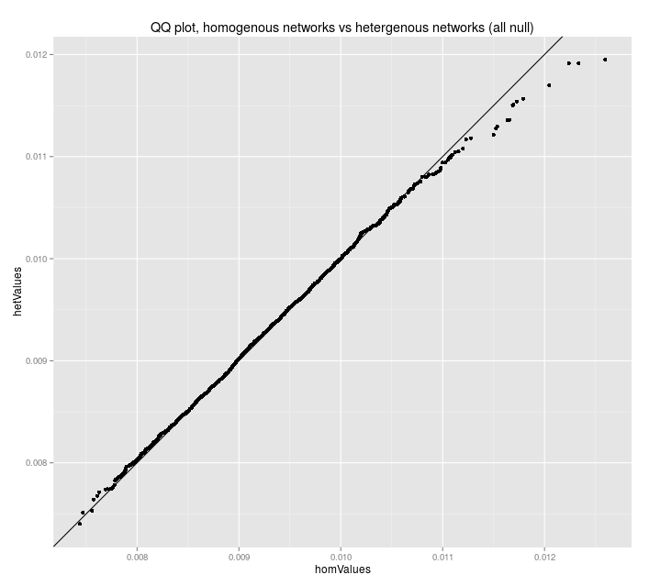
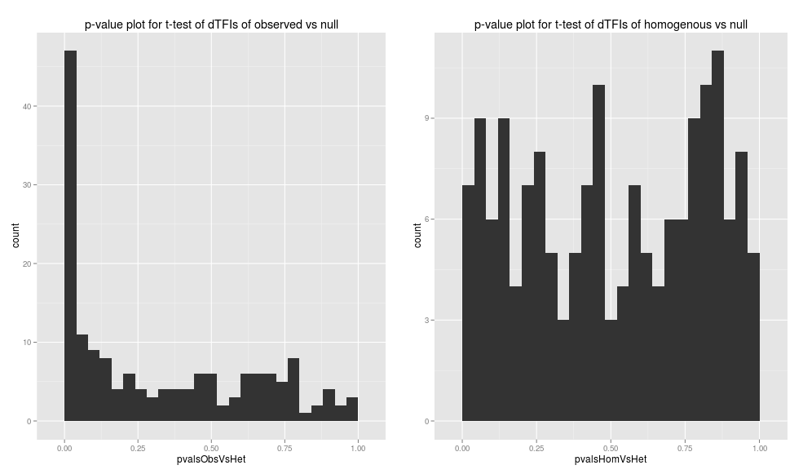
Is this a valid estimation of the null distribution of dTFI?
Yes! ... we think
Notes:
Si is the statistic that we use to identify specific TFI. We have not yet started to determine the specific characteristics it has acquired.

Slide 41
Application to a case-control COPD study
Differential transcription factor involvement distribution under the null (blue), with the observed differential TFI (red).
Notes:
Si is the statistic that we use to identify specific TFI. We have not yet started to determine the specific characteristics it has acquired.

Slide 42
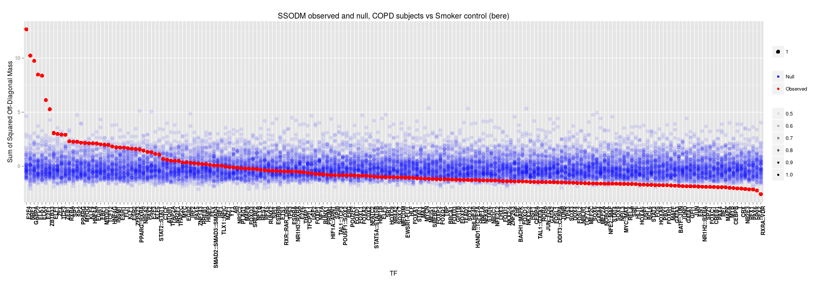
Application to a case-control COPD study
Observed differential TFI (red) standardized by the estimated distribution under the null.
Notes:
Si is the statistic that we use to identify specific TFI. We have not yet started to determine the specific characteristics it has acquired.

Slide 43
Application to a case-control COPD study
 | t-statistic | p-values | FDR | Sig (LIMMA) | Notes
E2F4 | 12.666 | 0.0000 | 0.0000 | 0.337 | Binds EGR-1, SMAD3. Tumor suppression.
NRF1 | 10.232 | 0.0000 | 0.0000 | 0.215 | Acts on nuclear genes encoding respiratory subunits and components of the mitochondrial transcription and replication machinery.
GABPA | 9.747 | 0.0000 | 0.0000 | 0.816 | Related to NRF1, involved in activation of cytochrome oxidase expression and nuclear control of mitochondrial function
ELK1 | 8.480 | 0.0000 | 0.0000 | 0.080 | Binds to the the serum response factor
ELK4 | 8.379 | 0.0000 | 0.0000 | 0.000 | Binds promoter of the c-fos proto-oncogene
E2F1 | 6.126 | 0.0000 | 0.0000 | 0.714 | E2F family...
ZBTB33 | 5.281 | 0.0000 | 0.0000 | 0.602 | shown to interact with HDAC3, Nuclear receptor co-repressor 1
ELF1 | 3.083 | 0.0010 | 0.0242 | 0.301 | primarily expressed in lymphoid cells
ZFX | 2.998 | 0.0014 | 0.0285 | 0.987 | gene on the X chromosome

Slide 44
Application to a case-control COPD study
Changing TF | Trainer TF | Gain/Loss | p-value | FDR
GABPA | SPIB | Loss | 1.07E-009 | 3.82E-005
E2F4 | PAX2 | Loss | 1.22E-008 | 2.17E-004
ELK4 | SPIB | Loss | 1.83E-008 | 2.18E-004
E2F4 | SPIB | Loss | 3.53E-008 | 3.15E-004
E2F4 | ZEB1 | Gain | 4.70E-008 | 3.36E-004
E2F4 | YY1 | Gain | 6.76E-008 | 4.02E-004
E2F4 | SREBF2 | Gain | 1.46E-007 | 7.46E-004
NRF1 | SPIB | Loss | 3.64E-007 | 1.63E-003
E2F4 | FOXL1 | Gain | 4.10E-007 | 1.63E-003
E2F1 | YY1 | Gain | 4.23E-007 | 1.51E-003
E2F4 | FOXD1 | Loss | 5.07E-007 | 1.65E-003
NRF1 | BACH1::MAFK | Gain | 5.39E-007 | 1.61E-003
E2F4 | BACH1::MAFK | Gain | 6.25E-007 | 1.72E-003
E2F4 | PPARG | Gain | 8.24E-007 | 2.10E-003
NRF1 | YY1 | Gain | 1.26E-006 | 3.00E-003
NRF1 | PPARG | Gain | 1.46E-006 | 3.27E-003
E2F4 | GABPA | Gain | 1.62E-006 | 3.40E-003
ELK4 | MYOG | Loss | 2.11E-006 | 4.19E-003
GABPA | ZEB1 | Gain | 2.24E-006 | 4.22E-003
GABPA | MYOG | Loss | 3.27E-006 | 5.83E-003

Slide 45
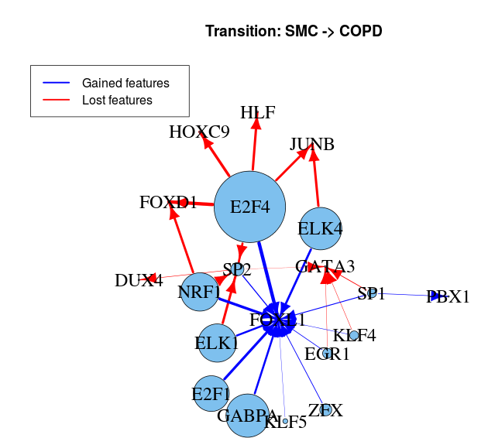
Application to a case-control COPD study

Slide 46
Part 2: Variance inflation for non-genetic associations of sharply defined, spatially separated phenotypes with rare, spatially separated alleles in GWAS

Slide 47
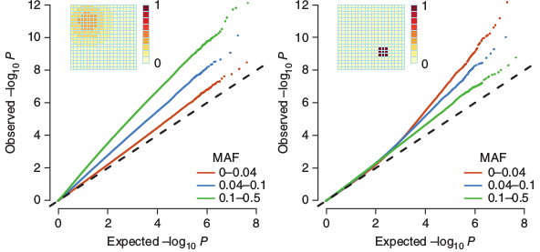
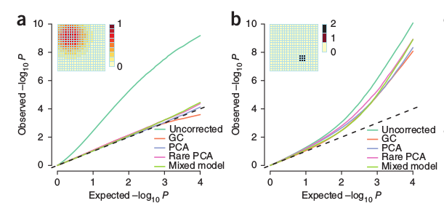
The Problem
Mathieson 2013

Slide 48
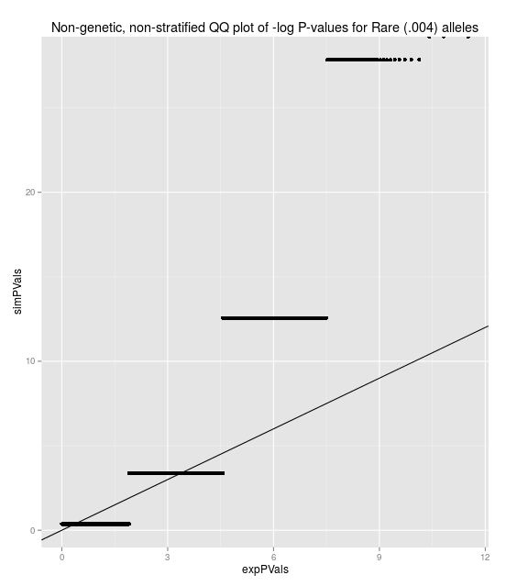
The issue is not just stratification!
Distribution of non-genetic, non-stratified armitage trend test is not chi-sq(1) for rare alleles.
E(ATT)=1
Var(ATT)!=2
For example, with no population stratification:
MAF=.004, PhenoFreq=.01
mean(ATT)=.997
Var(ATT)=3.1
This is a finite sample size issue.

Slide 49
But it's also stratification
However, correcting for stratification (even perfect correction) is insufficient to stop inflation.
Example:
After a perfect correction for stratification, for a genotype and phenotype that appear in only one subpopulation, for a non-genetic risk, ATT~n/n1*chi-sq(1)

Slide 50
There are at least 3 issues
1.) Common correction methods use linear functions to define risk and do not distinguish subpopulations well.
2.) Finite sample sizes yield inflated variance of ATT statistic.
3.) Differential genotype/phenotype variances lead to scaling of null test statistic distribution

Slide 51
The Approach
Find a superior method for more precise subpopulation identification
- Use rare alleles only
- Use Jaccard similarity instead of Variance-Covariance matrix
(Choose top eigenvectors based on eigendecomp)
Scale by a loci-specific variance inflation factor
Apply to most recent 1000GP data (much improved quality)

Slide 52
Inflation issues
Distribution of non-genetic, non-stratified armitage trend test is not chi-sq(1) for rare alleles.
E(ATT)=1
Var(ATT)!=2
For example, with no population stratification:
MAF=.004, PhenoFreq=.01
mean(ATT)=.997
Var(ATT)=3.1

Slide 53
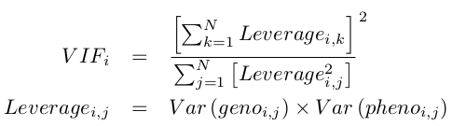
Individual SNP variance inflation
So we have a variance inflation factor of 1/n1 for that particular SNP.
Generalizing this we have
Where the leverage is the product of variance of genotype(i,j) and the variance of phenotype(i,j).
The variances are found by p(1-p) where p is the fitted value from the population correction.

Slide 54
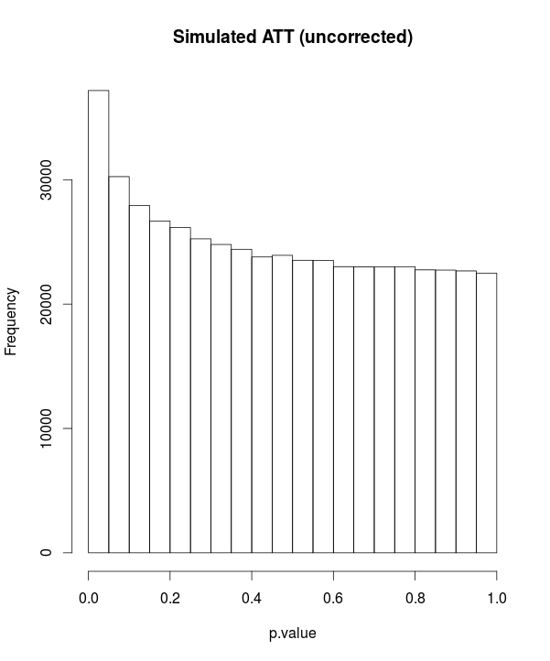
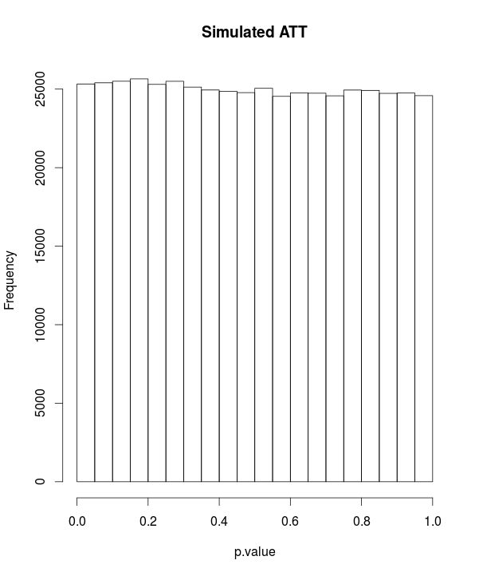
Correcting variance scaling
z <- (1:100)/200
zvar <- z*(1-z)
sumviSq <- sum(zvar)^2
sumSqvi <- sum(zvar^2)
vFactor <- 1/(sumSqvi/sumviSq)
hist(replicate(500000, {
x <- rbinom(100,1,prob=z)-z
y <- rbinom(100,1,prob=z)-z
1-pchisq(vFactor*cor(x,y)^2, 1)
vFactor*cor(x,y)^2
}))

Slide 55
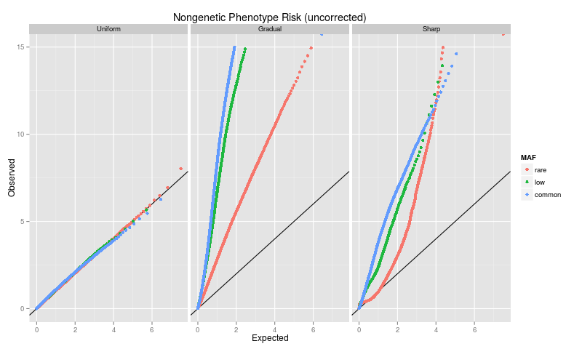
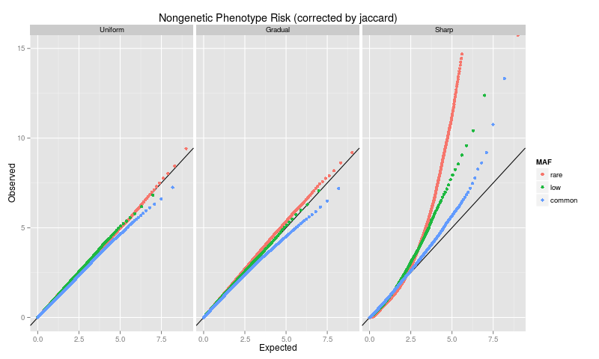
Variance inflation for associations of sharply defined, spatially separated phenotypes with rare, spatially separated alleles
1000GP

Slide 56
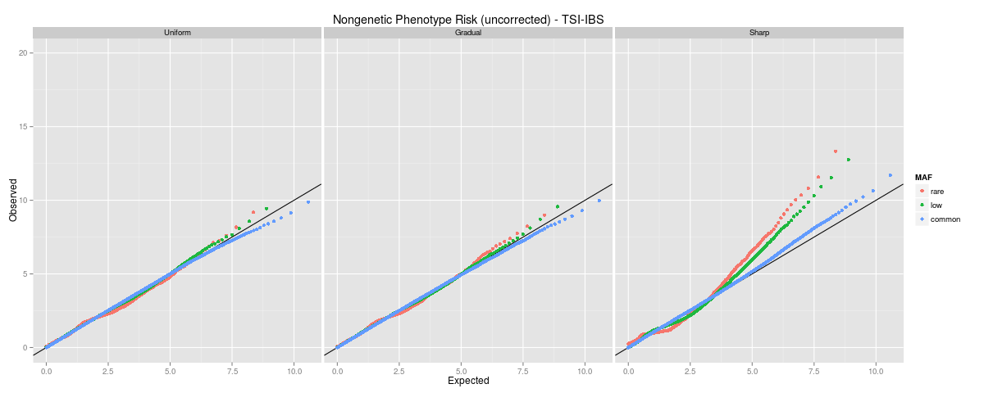
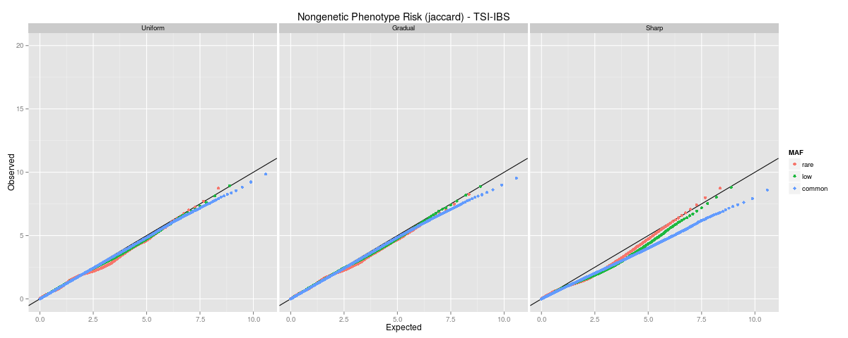
Variance inflation for associations of sharply defined, spatially separated phenotypes with rare, spatially separated alleles
1000GP

Slide 57
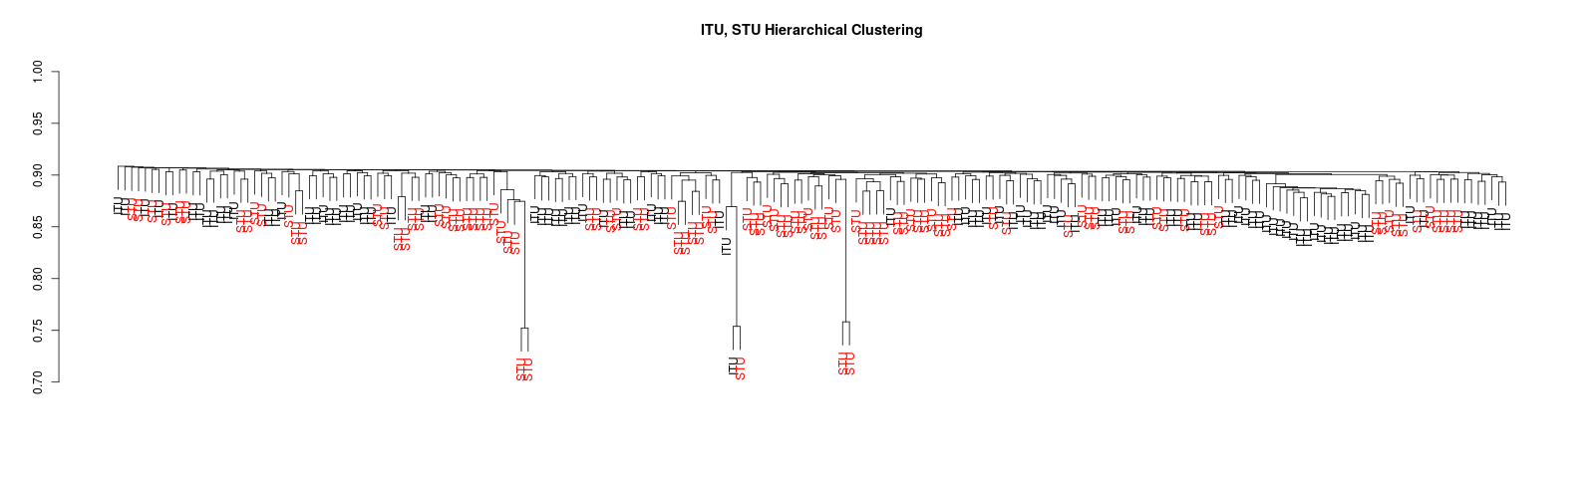
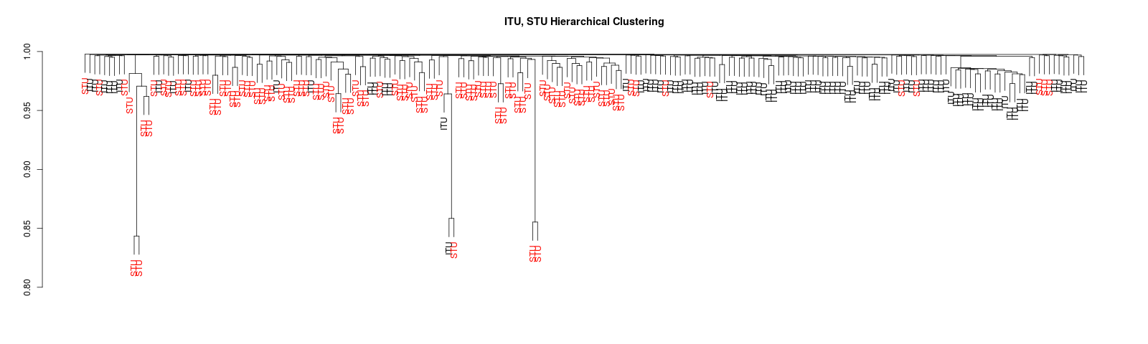
Variance inflation for associations of sharply defined, spatially separated phenotypes with rare, spatially separated alleles
Common (~10% MAF) alleles Hierachical Clusting via Jaccard similarity
Rare (<1% MAF) alleles Hierachical Clusting via Jaccard similarity

